Slide 1
Development Lectures
Introduction to Databases

Slide 2
Database
Primary purpose of a database is to store information
Why not just use a flat file?
Querying
Easy updates
Data integrity
Reduced Redundancy
Concurrent access

Slide 3
Why Database?
Let’s take a look at an Excel sheet (Database_Exercise.xls) I made and discuss the problems with it.

Slide 4
Relational Database
A relational database stores information in tables. Each informational topic is stored in its own table.
For example, a Project List could be divided into a CUSTOMER Table, a PROJECT Table, a PROJECT_MANAGER Table, and a PROJECT_TEAM table.

Slide 5
Relational Database
In a relational database, data is stored in several tables. Sometimes the tables must be joined back together in order to retrieve all of the desired data.
Tables are joined together using the value of certain data.
If a PROJECT has a CUSTOMER, the Customer_ID is stored as a column in the PROJECT table. The value stored in this column can be used to retrieve specific customer information from the CUSTOMER table.

Slide 6
Identifying Tables (Entities)
People, things, events, and locations
If an item you are considering as an entity doesn’t fit into one of these categories, chances are it is not an entity, but likely an attribute

Slide 7
Identifying Fields (Attributes)
Property or characteristic that describes an entity.
The fields / columns in the tables

Slide 8
Keys
Primary Key – a field (or collection of fields) that uniquely identify each record in a table.
Foreign Key – a field in one table that maps to a field in another table.

Slide 9
Keys
Natural Key – A key that is formed of attributes that already exist in the data (e.g. SSN)
Surrogate Key – a key with no business meaning
Composite Key – a key that is composed of two or more attributes

Slide 10
Composite Primary Key
You can have multiple fields as your primary key, called a composite primary key
I am not a fan of this because
Problems with concurrency
If two users are currently working with the same information set, such as a customer row, and one of the users modifies a field in the composite key, then an update by the second user will fail because the field they were using no longer exists
JOINS can become a pain
DB must maintain two indexes instead of one, and therefore can be slower

Slide 11
Relationships
When one table refers to another table, this is called a relationship.
There are several types of database relationships:
One to One Relationships
One to Many and Many to One Relationships
Many to Many Relationships
Self Referencing Relationships

Slide 12

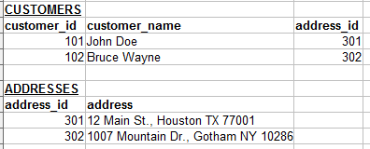
One-to-One Relationships
Let's say you have a table for customers:
The customer address information could be in a separate table.

Slide 13
One-to-One Relationships
Now there is a relationship between the Customers table and the Addresses table.
If each address can belong to only one customer, this relationship is "One to One".
Keep in mind that this kind of relationship is not very common. Most times, one-to-one relationships could just be placed in one table.

Slide 14
One to Many and Many to One Relationships
This is the most commonly used type of relationship.
Consider an e-commerce website, with the following:
Customers can make many orders.
Orders can contain many items.
Items can have descriptions in many languages.

Slide 15
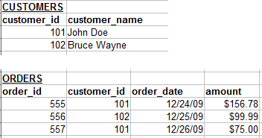
One to Many and Many to One Relationships
In these cases we would need to create "One to Many" relationships. Here is an example:
Each customer may have zero, one or multiple orders. But an order can belong to only one customer.

Slide 16
Many to Many Relationships
In some cases, you may need multiple instances on both sides of the relationship.
For example, each order can contain multiple items. And each item can also be in multiple orders.

Slide 17
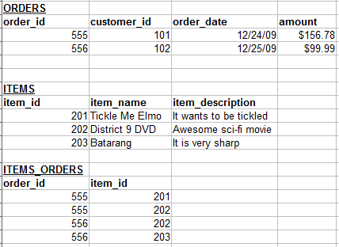
Many to Many Relationships
For these relationships, we need to create an extra table:

Slide 18

Self Referencing Relationships
This is used when a table needs to have a relationship with itself.
For example, let's say you have a referral program. Customers can refer other customers to your shopping website. The table may look like this:

Slide 19
Properly Formed Databases
There is more to database design than identifying tables and attributes
Normalization is the process of making sure your database is formed properly
Minimizes redundancy and dependency
There are many different normal forms, but a database is accepted as “normalized” if it meets 1^{st,} 2nd, and 3rd normal form

Slide 20
Normalization
1st normal form
Table has a primary key
No repeating groups of columns in an entity
Example:
Order
OrderDate
Product1
Product2
Product3
Order
OrderID <PK>
OrderDate
OrderItems
OrderItemID <PK>
OrderID <FK>
Product
Product repeating column

Slide 21
Normalization
2nd normal form
All attributes of an entity should be fully dependent on the whole primary key (this situation happens when there is a composite primary key)
OrderItems
OrderID <PK>
ProductID <PK>
OrderDate
Quantity
Not dependent upon ProductID, so doesn’t belong in this table

Slide 22
Normalization
3rd normal form
All attributes need to be directly dependent on the primary key, and not on other attributes
OrderItems
OrderID <PK>
ProductID <PK>
UnitPrice
Quantity
Total
Total can be derived by multiplying the unit price by the quantity, therefore it is not fully dependent upon the primary key and should be removed from the table.

Slide 23
Normalization
3rd normal form
To be third normal form, you will not always remove an attribute
Employee
EmployeeNumber <PK>
FirstName
LastName
DepartmentNumber <FK>
Department
DepartmentNumber <PK>
DepartmentName
Employee
EmployeeNumber <PK>
FirstName
LastName
DepartmentNumber
DepartmentName
DepartmentName is dependent on DepartmentNumber, not EmployeeNumber

Slide 24
Normalization
3rd normal form – third example
InventoryItem
InventoryItemID <PK>
PartNumber
PartName
WarehouseID
Warehouse_Address
Quantity
InventoryItem
InventoryPartID <PK>
PartNumber <FK>
WarehouseID <FK>
Quantity
Parts
PartNumber <PK>
PartName
Warehouse
WarehouseID <PK>
Warehouse_Address

